Slide 1

Information Retrieval Chapter 6: Text Categorization and Filtering TY B.Sc. (CS)
Semester VI
Poornima .N
Assistant Professor, Department of IT/CS
1

Slide 2

1 Topics:
Text classification algorithms:
Naive Bayes
Support Vector Machines
Feature selection and dimensionality reduction
Applications of text categorization and filtering

Slide 3
2 Text Classification – Introduction
In traditional search, users perform ad hoc retrieval (one-time queries) • Some information needs are ongoing and repetitive • Example: Daily tracking of news on multicore computer chips

Slide 4
Standing Queries
Standing Query • A saved query that runs periodically on new documents • Used to automate repetitive searches
🧠 Example:
multicore AND computer AND chip

Slide 5
3 Limitations of Standing Queries
⚠️ Simple queries miss relevant documents
Reasons: • Different terms express same concept •
Example: processor, microprocessor, multi-core
➡️ Leads to low recall

Slide 6
3 Refining Standing Queries (Rule-Based Classification)
Improved query using Boolean rules:
(multicore OR multi-core)
AND
(chip OR processor OR microprocessor)
❌ Queries become complex over time ❌ Hard to create and maintain

Slide 7
3 Classification Concept
📂 Text Classification
• Task of assigning documents to predefined classes
Example classes:
• Documents about multicore chips
• Documents not about multicore chips
🔹 Also called:
• Routing
• Filtering

Slide 8
4 Importance of Text Classification
Text classification is used in:
• Spam detection
• Sentiment analysis
• Email sorting
• Content filtering
• Vertical search engines
➡️ Foundation for machine learning methods like Naive Bayes

Slide 9
7 MINI CLASSROOM EXERCISE 1
Exercise 1: Word-Based Classification (No maths)
Step 1: Give classes
Class A: Sports
Class B: Technology
Step 2: Give documents 1️⃣ “The team won the match” 2️⃣ “New processor improves performance” 3️⃣ “The player scored a goal”
Ask students:
“Which class will Naive Bayes choose and WHY?”

Slide 10
7 MINI CLASSROOM EXERCISE 2
Exercise 2: Word-Based Classification (No maths)
Words | Spam | Not Spam
free | yes | no
meeting | no | yes
offer | yes | no
Document:
“free offer”

Slide 11
4 Introduction to Naive Bayes
Naive Bayes Classifier
• A machine learning method for text classification
• Uses probability to decide the class of a document
• Learns from labeled training data

Slide 12
5 Intuition Behind Naive Bayes
Key idea:
• Certain words indicate certain topics
Examples:
• goal, match, team → Sports
• election, vote, party → Politics
➡️ Naive Bayes learns this using probabilities

Slide 13
5 How Naive Bayes thinks
“Naive Bayes asks one question: Which class is more probable for this document?”
For each class, it checks:
How often do these words appear in this class?

Slide 14
6 How Naive Bayes Works (High Level)
For a new document:
1️⃣ Look at the words in the document
2️⃣ Estimate how likely these words are for each class
3️⃣ Compute probability for each class
4️⃣ Choose the class with highest probability

Slide 15
6 Why is it Called Naive Bayes?
🔹 Bayes • Based on Bayes’ theorem (probability rule)
🔹 Naive • Assumes words are independent of each other
• This assumption is simple but effective

Slide 16
6 Why Naive Bayes is Popular
✅ Simple and easy to understand
✅ Fast and efficient
✅ Works well for large text collections

Slide 17
7 Bayes theorem
P(c | d) = P(d | c) × P(c) / P(d)

Slide 18
7 Naive Bayes
P(c | d) ∝ P(c) × ∏ P(wᵢ | c)

Slide 19
7 Text Classification Problem
Given:
Document space X
Set of classes C = {c₁, c₂, …, cⱼ}
Goal: Assign each document to exactly one class

Slide 20
7 Document Space (X)
“We are given a description d ∈ X of a document, where X is the document space.”
X (document space) = all possible documents the system can see
Each document d belongs to this space

Slide 21
7 Classes (C)
“A fixed set of classes C = {c1, c2, …, cJ}”
Classes = labels or categories
They are decided by humans, not the computer

Slide 22
7 Training Set (D) (Supervised Learning)
“We are given a training set D of labeled documents ⟨d, c⟩”
Training set = documents where we already know the correct class
Each document comes with a label

Slide 23
7 What does P(c | d) mean?
P(c | d)
“Probability of class c, given document d”
So Naive Bayes is asking:
“Given this document, how likely is it to belong to class c?”

Slide 24
7 What is P(c)?
P(c)
This is the prior probability of class c.
“How common is class c in training data?”
Example:
100 training documents
30 are China
P(China) = 30 / 100

Slide 25
7 What is P(d | c)?
“If the document belongs to class c, how likely is it to look like this?”
But documents are made of words, so…

Slide 26
7 Learning Method & Classifier (Γ and γ)
1️⃣ Learning method (Γ)
The process
The algorithm
Example: Naive Bayes learning method
2️⃣ Classifier (γ)
The result
The function that actually classifies documents.
γ : X → C

Slide 27
6 Naive Bayes – Probabilistic Model
📌 Goal: • Find the most probable class for a document
For a document d and class c:
➡️ Choose the class with maximum:
P(c | d)

Slide 28
8 Text Classification Problem Example
Document: "Beijing joins WTO"
Class: China

Slide 29


9 Classifier Function
Classifier (γ):
Meaning:
Input → Document
Output → One class
Example:

Slide 30
14 1. Examples
Imagine you are a Library Helper. Your job is to take a book and decide if it goes in the "Horror" section or the "Romantic Comedy" section.

Slide 31
14 1. The Starting Guess (The "Prior")
Before you even open the book, you look at the library. You notice that 80% of the library is Horror books.
In the formula: This is P(c). It’s the "Starting Score" based on what you already have.

Slide 32
14 2. The Clues (The "Evidence")
Now, you open the book and look at three random words: "Blood", "Shadow", and "Kiss".

Slide 33
14 2. The Clues (The "Evidence") with datasets
Word | Chance in Horror | Chance in Rom-Com
"Blood" | Very High (10 points) | Very Low (0.1 points)
"Shadow" | High (5 points) | Low (1 point)
"Kiss" | Low (1 point) | Very High (10 points)

Slide 34
14 3. The Math (The "Multiplication")
To find the final score, you multiply your Starting Guess by the word scores.

Slide 35
14 3. The Math (The "Multiplication") Horror Score:
Horror Score:
Start with 80 (because Horror is common).
Multiply by 10 (for "Blood").
Multiply by 5 (for "Shadow").
Multiply by 1 (for "Kiss").
Total = 4,000 points.

Slide 36
14 3. The Math (The "Multiplication") Rom-Com Score:
Rom-Com Score:
Start with 20 (it's less common).
Multiply by 0.1 (for "Blood").
Multiply by 1 (for "Shadow").
Multiply by 10 (for "Kiss").
Total = 20 points.

Slide 37
15 4. The Decision (The Winner)
4,000 is much bigger than 20. So, you put the book in the Horror section.
That " ∝ " symbol in the formula just means: "We are looking for the biggest score."

Slide 38
Support Vector Machines (SVM)

Slide 39
15 Support Vector Machines (SVM)
Definition: A machine learning model used to separate data into two classes by finding a specific decision boundary.
Goal: To find a boundary that not only separates the data but stays as far away from the points as possible.

Slide 40
15 Hyperplane
Definition: The "fence" or decision surface that separates different classes of data.
Simple Meaning: In 2D space, it's a line. In 3D space, it's a flat plane. In higher dimensions, we call it a hyperplane.

Slide 41
15 Margin
Definition: The distance between the decision boundary (the fence) and the closest data points from each class.
The Strategy: SVM is a "large-margin classifier," meaning it tries to maximize this empty space to ensure a safety buffer.

Slide 42
15 Support Vectors
Definition: The specific data points that lie exactly on the edge of the margin.
Why they matter: They are the "pillars" that support the boundary. If you move these points, the boundary moves. If you move any other points, the boundary stays the same.

Slide 43
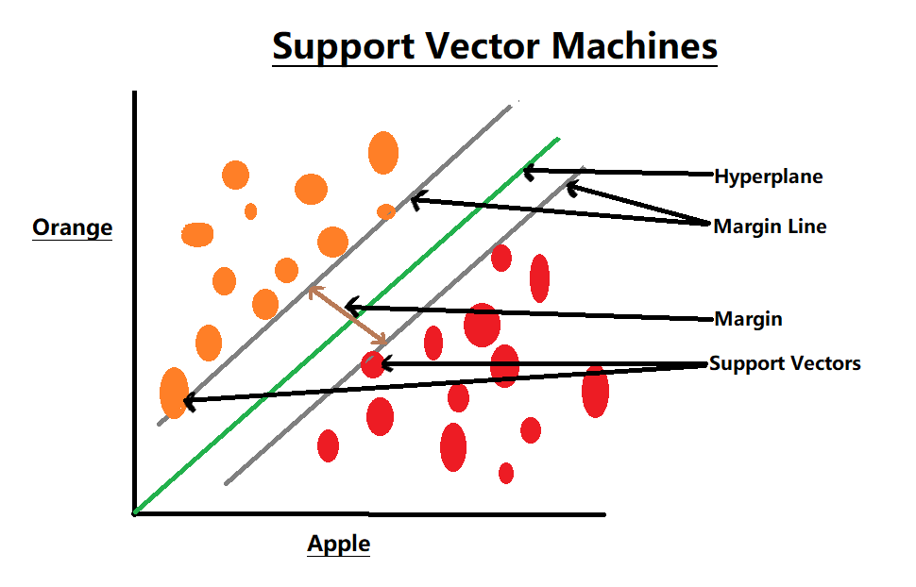

Slide 44
15 Where This Topic Fits
You already learned Naive Bayes and SVM classifiers
Question: What do we feed into these algorithms?
Answer: Features (terms/words)
Problem: Text data has too many features 🚨

Slide 45
15 The Core Problem in Text Data
Each unique word = one feature
Typical dataset:
Documents: 1,000
Vocabulary: 50,000+ words
Results in:
High dimensional vectors
Sparse data
Slow training
Overfitting
👉 Solution: Feature Selection & Dimensionality Reduction

Slide 46
15 Feature Selection – Intuition
Goal: Select the most useful words
Remove:
Irrelevant words
Redundant words
Noisy words
Example:
Keep: exam, result, admission
Remove: the, is, and, very

Slide 47
15 Feature Selection – Formal Definition
Feature Selection = choosing a subset of original features
Vocabulary size reduces:
From 50,000 → 5,000
Important point:
Words remain interpretable

Slide 48
15 Common Feature Selection Methods (IR Focus)
1. Document Frequency (DF
2. Information Gain (IG)
3. Chi-Square (χ²) Test

Slide 49
15 Feature Selection Summary Table
Method | Idea | Used When
DF | Frequency based | Simple filtering
IG | Information contribution | Classification
Chi-square | Statistical dependence | Category analysis

Slide 50
15 Dimensionality Reduction – Intuition
Instead of selecting words,
Transform features into new dimensions
Key difference:
Feature Selection → keeps words
Dimensionality Reduction → creates new features

Slide 51
15 Dimensionality Reduction – Definition
Convert high-dimensional data into lower dimensions
Preserve important information
Example:
10,000 word dimensions → 100 dimensions

Slide 52
15 Latent Semantic Analysis (LSA)
Uses Singular Value Decomposition (SVD)
Captures hidden (latent) topics
Benefits:
Handles synonymy
Reduces noise
Used in:
Information Retrieval
Text similarity

Slide 53
15 Principal Component Analysis (PCA)
Statistical dimensionality reduction technique
Finds directions of maximum variance
Note for students:
PCA is not word-based
Components are not interpretable

Slide 54
15 Feature Selection vs Dimensionality Reduction
Feature Selection | Dimensionality Reduction
Selects words | Creates new features
Interpretable | Not interpretable
Faster | More computation
Used widely in IR | Used in advanced IR

Slide 55
15 Applications of Text Categorization
Text Categorization = Assigning documents to predefined classes
Examples:
News classification
Email sorting
Academic paper classification

Slide 56
15 Applications of Text Filtering
Email filtering
News personalization
Content moderation
Recommendation systems

Slide 57

Thank you…

